Slide 1
CS 331
Topic: Polymorphism and Virtual Functions Part 1
MD Romael Haque

Slide 2
Type Compatibility in Inheritance Hierarchies
So far we’ve learned that it often makes sense to create a new class based on an existing class if the new class is a special version of the existing one.
The derived class can then itself serve as the base class for other classes, resulting in an inheritance hierarchy.

Slide 3
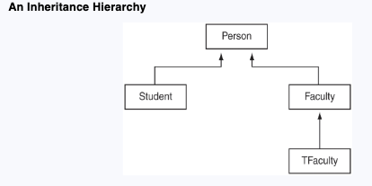
Type Compatibility in Inheritance Hierarchies
In our previous example- we used the process of inheritance to create a hierarchy of several classes: Person, Student, Faculty, and TFaculty.
The relationship of inheritance is normally depicted using rectangles to represent the classes and arrows pointing from the derived class to the base class

Slide 4
Type Compatibility in Inheritance Hierarchies
In our previous example- we used the process of inheritance to create a hierarchy of several classes: Person, Student, Faculty, and TFaculty.
This hierarchy may of course be extended. For example, the Student class might itself be used as a base class for two other derived classes, CStudent and RStudent.
These last two classes might be used to represent a type of student that commutes and another type of student that is resident on campus.
The relationship of inheritance is normally depicted using rectangles to represent the classes and arrows pointing from the derived class to the base class

Slide 5
Type Casting
A type cast is a way to explicitly convert a variable from one data type to another.
In object-oriented programming, particularly in languages like C++, type casting is used to convert pointers or references from one class type to another, especially within inheritance hierarchies.
Type casting can also be applied to basic data types, like converting an integer to a floating-point number (We’ve seen that).

Slide 6
Implicit Casting (Automatic Type Conversion)
The compiler automatically performs certain conversions when the target type can safely hold the original type’s value.
Example: Assigning an int to a double (e.g., int a = 5; double b = a;). Here, a is implicitly converted to a double.

Slide 7
Explicit Casting (Manual Type Conversion)
You, the programmer, tell the compiler to convert a type explicitly using different forms of casting.
In C++, there are specific type cast operators:
Static Cast
Dynamic Cast
Const Cast
Reinterpret Cast

Slide 8
Explicit Casting: Static Cast
Used for conversions that are known at compile time and where the programmer is confident in the type being cast.
Example:
double d = 9.7;
int a = static_cast<int>(d); (converts double to int by truncating).

Slide 9
Explicit Casting: Dynamic Cast
dynamic_cast performs a runtime check to ensure that the object being cast is of the correct derived type.
If not, it returns nullptr for pointers or throws an exception for references.
Example:
Base* basePtr = new Derived();
Derived* derivedPtr = dynamic_cast<Derived*>(basePtr);

Slide 10
Type Compatibility in Inheritance
In an inheritance hierarchy, type compatibility refers to how objects of different classes relate to each other, especially when it comes to assigning pointers.
Certain type compatibility relationships hold among different classes in an inheritance hierarchy.
Because objects in an inheritance hierarchy are commonly accessed through pointers, we need to understand a few rules in terms of pointers.

Slide 11
Type Compatibility in Inheritance
Rule 1: A derived class pointer can always be assigned to a base class pointer.
A pointer to a derived class can be assigned to a pointer of its base class without any type casting.
This is because a derived class is an extension of its base class, so it is always safe for a base class pointer to refer to a derived class object.
Example: Given class Dog : public Animal, if we create a Dog object, a Animal* pointer can safely point to it, since Dog "is an" Animal.

Slide 12
Type Compatibility in Inheritance
Rule 2: A type cast is required to perform the opposite assignment of a base class pointer to a derived class pointer.
An error may result at run time if the base class pointer does not actually point to a derived class object.
Assigning a base class pointer to a derived class pointer is not directly allowed, as it is potentially unsafe.
A base class may not contain all the details of a derived class.

Slide 13
Type Compatibility in Inheritance
A type cast (e.g., using static_cast or dynamic_cast) is required to tell the compiler you intend to treat the base class pointer as a derived class pointer.
Example: If you have a pointer Animal* animalPtr, and you know it actually points to a Dog object, you would use
Dog* dogPtr = dynamic_cast<Dog*>(animalPtr);
However, if animalPtr does not point to a Dog object (e.g., it points to a Cat object), this casting could cause runtime errors or undefined behavior.

Slide 14
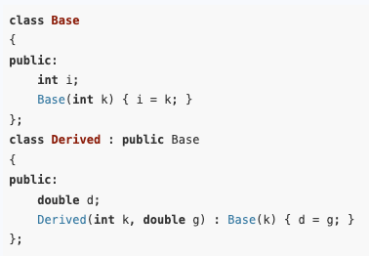
Type Compatibility in Inheritance
Let’s look at an example to show how these rules work with both raw and smart pointers.

Slide 15
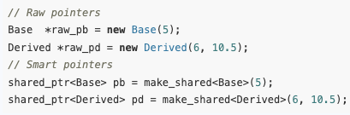
Type Compatibility in Inheritance
Given these classes, we can have raw and smart pointers to both base and derived class objects:

Slide 16
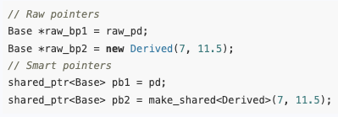
Type Compatibility in Inheritance
The first rule says we can assign derived class pointers to base class pointers. Thus we can write:

Slide 17

Type Compatibility in Inheritance
The second rule says we can assign a base class pointer to a derived class pointer if we use a type cast.
With raw pointers, the appropriate cast is static_cast. For shared_ptr, you must use static_pointer_cast:
Assuming that the base pointers were previously pointing to derived class objects, these assignments will leave pd1 and raw_pd1 pointing to derived class objects.
Subsequently, you will be able to use those pointers to access derived class members:

Slide 18


Type Compatibility in Inheritance
Consider now a scenario in which a base class pointer that is pointing to a base class object is assigned to a derived class pointer using a type cast:
The statement compiles correctly but will cause an error when it is executed.
After such an assignment, an attempt such as to access Derived class members will fail, because the Base class object pointed to by raw_pd (or pd) does not have the member d.

Slide 19
Type Casting of Base Class Pointers
We have seen that a pointer to a particular class may actually be pointing to an object of a derived class.
In this case, the class type of the pointer will be different from the class type of the object.
As an example, consider the statement
Even though this assignment is legal, the pPerson pointer is not aware of Faculty class members other than those inherited from Person.

Slide 20

Type Casting of Base Class Pointers
Consequently, an attempt to access non-inherited members of the Faculty class through pPerson is rejected by the compiler:
If we do know that pPerson actually points to a Faculty object, we can use a type cast to coax the compiler to accept the statement:
The type cast informs the compiler that pPerson is actually pointing to a Faculty object.

Slide 21
Type Casting of Base Class Pointers
Alternatively, we can first cast pPerson to a pointer to Faculty stored in pFaculty and then use that to access Faculty-specific members:

Slide 22
Type Casting of Base Class Pointers
In general, a pointer to a base class that actually points to a derived class object must be appropriately cast before the additional features of the derived class can be used.
We know, derived class may override member functions that are defined in its base class.
When a pointer to a base class is being used to access a member function that has been overridden by the derived class, the default C++ behavior is to use the version of the function that is defined in the class of the pointer rather than in the class of the object.

Slide 23

Type Casting of Base Class Pointers
For example, this code sets pP, which is a pointer to the base class Person, to point to a TFaculty object.
Note that TFaculty overrides the getName function defined in Person.
In executing the statement - cout << pP−>getName();
The compiler is not aware that the actual class type of the object is TFaculty.
The compiler sees the class type of the pointer and assumes that the class type of the object is the same as that of the pointer.
Therefore, it calls the version of getName defined in the Person class.

Slide 24
Polymorphism and Virtual Member Functions
A piece of code is said to be polymorphic if executing the code with different types of data produces different behavior.
For example, a function would be called polymorphic if it executes differently when it is passed different types of parameters.

Slide 25
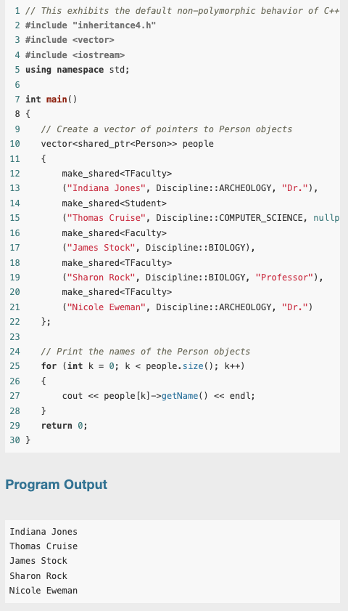
Polymorphism and Virtual Member Functions
To illustrate polymorphism, consider this program.
The program creates a vector of (pointers to) Person objects of type Student, Faculty, and TFaculty.
It then prints the names in all the objects using the same code.

Slide 26
Polymorphism and Virtual Member Functions
Notice that the program calls the Person version of the getName function for all objects in the array, even though the TFaculty objects have their own, more specialized version.
This code is obviously not polymorphic, for it executes the same member function for each object, regardless of its type.
In other words, it does not behave differently for different types of objects.

Slide 27
Polymorphism and Virtual Member Functions
To better understand what is happening, we need to take a closer look at each of the five calls used to retrieve the name to be printed: people[k]−>getName()
In each of these calls, a pointer people[k] to the base class Person is used to invoke the getName function in objects of different derived classes.
Some of these classes, like TFaculty, override getName to provide a more specialized version of that function.

Slide 28
Polymorphism and Virtual Member Functions
When people[k] is pointing to a TFaculty object, the compiler must choose between the getName defined in Person, the class of the pointer, and the getName defined in TFaculty, the class that the object actually belongs to.
The default C++ behavior is to use the class type of the pointer rather than that of the object to determine which version of an overridden function to call.

Slide 29
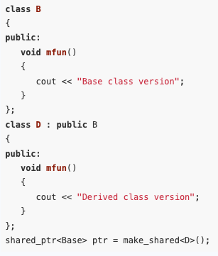
Polymorphism and Virtual Member Functions
The scenario of invoking a member function of a derived class object through a base class pointer is a common occurrence in object-oriented programming.
Let us say that we have a base class B with a member function mfun() and a base class pointer ptr that is pointing to an object of a derived class D.

Slide 30
Polymorphism and Virtual Member Functions
We want to tell the compiler that whenever we write
ptr−>mfun()
the compiler should select the more specialized version of mfun() in the derived class.
We can do this in C++ by declaring mfun() to be a virtual function in the base class.
Virtual functions are used in C++ to support polymorphic behavior.

Slide 31
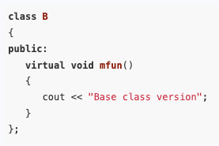
Polymorphism and Virtual Member Functions
Thus, to achieve polymorphic behavior for mfun() in the class B and all of its derived classes, we must modify the definition of B as follows:

Slide 32
Polymorphism and Virtual Member Functions
The virtual characteristic is inherited: That is, if a member function of a derived class overrides a virtual function in the base class, then that member function is automatically virtual itself.
Thus, the declaration of mfun as virtual in B makes mfun virtual in D and in all classes derived from D.
In our example, the virtual function has been defined inside the class declaration.
If a virtual member function is defined outside of the class declaration, the virtual key word goes on its declaration inside the class but not on the definition.

Slide 33
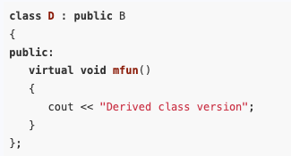
Polymorphism and Virtual Member Functions
Although it is not necessary, many programmers tag all virtual functions with the key word virtual to make it easer to identify them.
This is good practice, and accordingly, the definition of D should be written as follows:

Slide 34
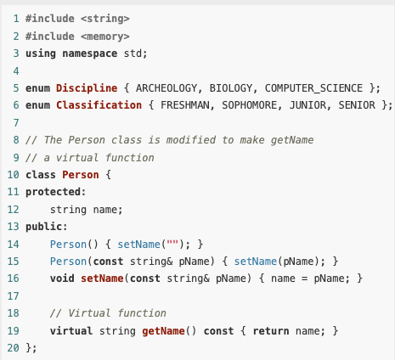
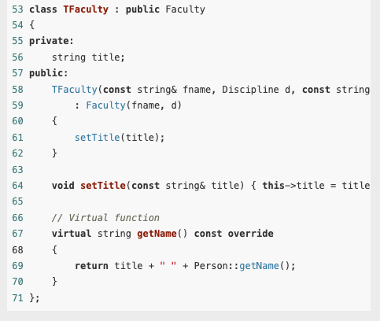
Example

Slide 35
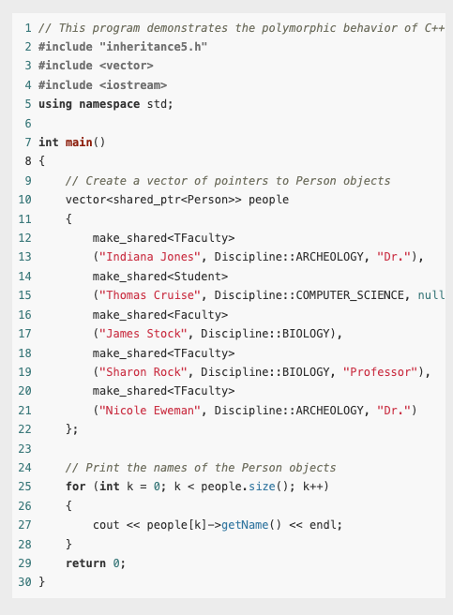

Example

Slide 36
Dynamic and Static Binding
The compiler is said to bind the name of a function when it selects the code that should be executed when the function name is invoked.
In other words, the compiler binds the name to a function definition when the function is called.

Slide 37
Dynamic and Static Binding
Static binding happens at compile time and binds the name to a fixed function definition, which is then executed each time the name is invoked.
In static binding, the compiler uses type information available at compile time.
If the code is operating on objects of different classes within an inheritance hierarchy, the only type information available to the compiler will be the base class pointer type used to access all the objects.
Consequently, static binding will always use the base class version of a member function.

Slide 38
Dynamic and Static Binding
In contrast, dynamic binding occurs at run time.
Dynamic binding works only if the compiler can determine at run time the exact class that a subclass object belongs to.
The compiler then uses this run-time type information to call the version of the function defined in that class.
To make dynamic binding possible, the compiler stores run-time type information in every object of a class with a virtual function.
Dynamic binding always uses the version of the member function in the actual class of the object, regardless of the class of the pointer used to access the object.

Slide 39
C++ 11’s override and final Key Words
C++ 11 introduces the override key word to help prevent subtle errors when overriding virtual functions.

Slide 40
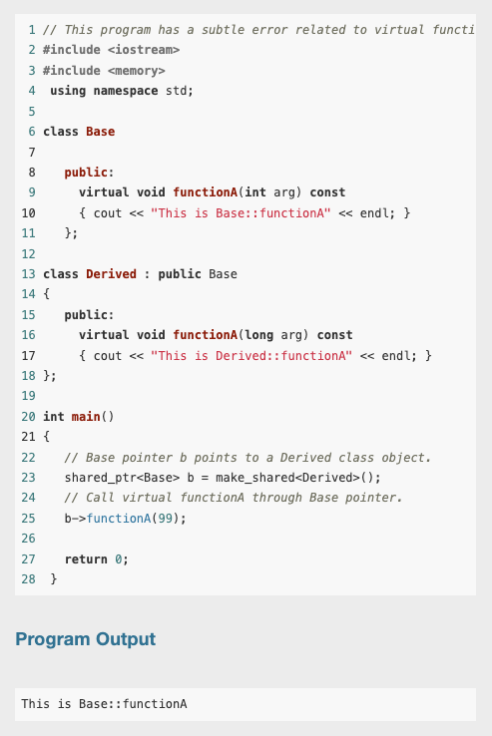
C++ 11’s override and final Key Words
There is a mistake in this program
In this program, a Base class pointer b is pointing to a Derived class object.
Because the functionA is virtual, we expect that the call to functionA through b will call the Derived class version.
This is not the case, however, as you can see from the program’s output.

Slide 41
C++ 11’s override and final Key Words
The reason is that the the two functions have different parameter types, so functionA in the Derived class does not override functionA in the Base class.
The function in the base class takes an int argument, but the one in the derived class takes a long argument.
So, functionA in the Derived class merely overloads functionA in the Base class.

Slide 42
C++ 11’s override and final Key Words
To make sure that a member function in a derived class overrides a virtual member function in a base class, you can place the override key word just after the derived class’s function prototype (or the function header, if the function is written inline).
The override key word tells the compiler that the function is supposed to override a function in the base class.
It will cause a compiler error if the function does not actually override any functions.

Slide 43
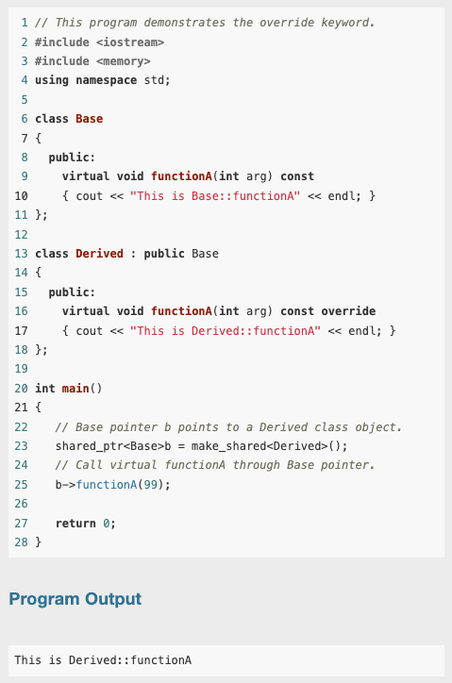
C++ 11’s override and final Key Words
This example demonstrates how previous example can be fixed so that the Derived class function does in fact override the Base class function.
Notice in line 16 that we have changed the parameter in the Derived class function to int, and we have added the override key word to the function header.

Slide 44
Preventing a Member Function from Being Overridden
In some derived classes, you might want to make sure that a virtual member function cannot be overridden any further down the class hierarchy.
When a member function is declared with the final key word, it cannot be overridden in a derived class.
The following member function prototype is an example that uses the final key word:
virtual void message() const final;
If a derived class attempts to override a final member function, the compiler generates an error.

